Slide 1
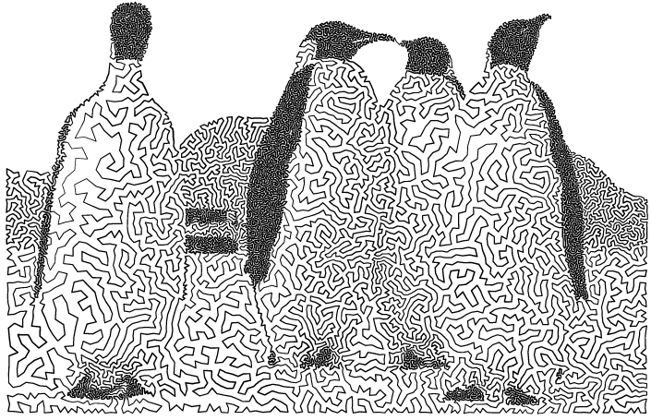
TSP Art
Adhish Shrivastava (as3003), Rutgers University
Yash Nisar (ymn6), Rutgers University
Yi-Hsiang Lo (yl1256), Rutgers University

Slide 2
Outline
1. Description
a. Travelling Salesman Problem
b. Algorithm
c. Example
d. Analysis of The Nearest Neighbor Algorithm
e. Implementation
2. Project Stumbling Blocks
3. Data collection, Flow Diagram, Integrity Constraints
4. Sample Findings
5. Future Extensions
6. Acknowledgements
7. References and Resources used(libraries, languages, web resources)

Slide 3
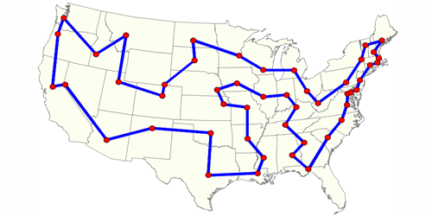
Traveling Salesman Problem
The travelling salesman problem (TSP) asks the following question:
“Given a list of cities and the distances between each pair of cities, what is the shortest possible route that visits each city and returns to the origin city?” - Wikipedia
It is an NP-hard problem in combinatorial optimization, important in operations research and theoretical computer science.

Slide 4
Algorithm
Below is the application of nearest neighbour algorithm to the travelling salesman problem . These are the steps of the algorithm:
1. start on an arbitrary vertex as current vertex.
2. find out the shortest edge connecting current vertex and an unvisited vertex V.
3. set current vertex to V.
4. mark V as visited.
5. if all the vertices in domain are visited, then terminate.
6. Go to step 2.
7. The sequence of the visited vertices is the output of the algorithm.

Slide 5
Example
This is the step-wise approximate solution by nearest neighbor method. This case has 5 nodes. We start with the node A and perform the nearest neighbor algorithm.

Slide 6
Example (contd…)

Slide 7
Analysis
For each point, you have to compute the distance between that point and all other points, which is O(n).
A hashmap can be maintained to check if the vertex has been visited or not and would consume a constant amount of time.
You have to compute this for n points, so for each point we get a factor of O(n). Thus for n points, the time complexity would be O(n²).

Slide 8
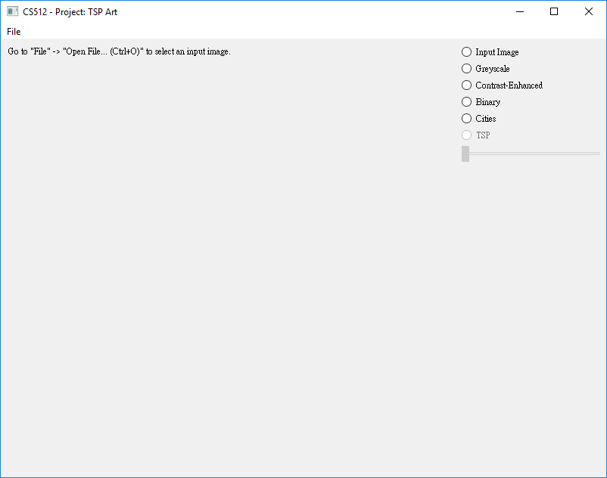
Implementation
Screen 1: Home screen

Slide 9
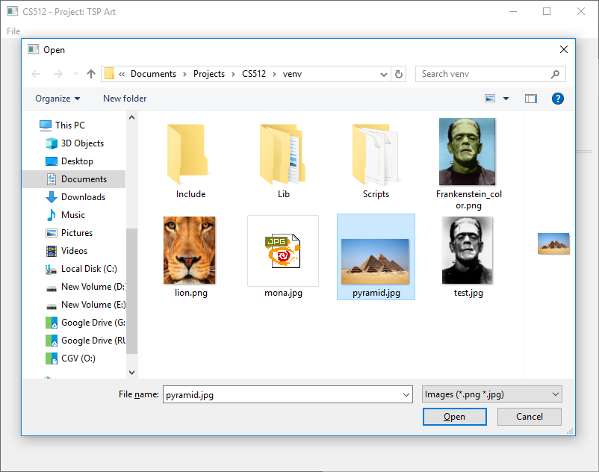
Implementation (contd…)
Screen 2: User selects an image on which he/she wants to apply the TSP Art algorithm

Slide 10
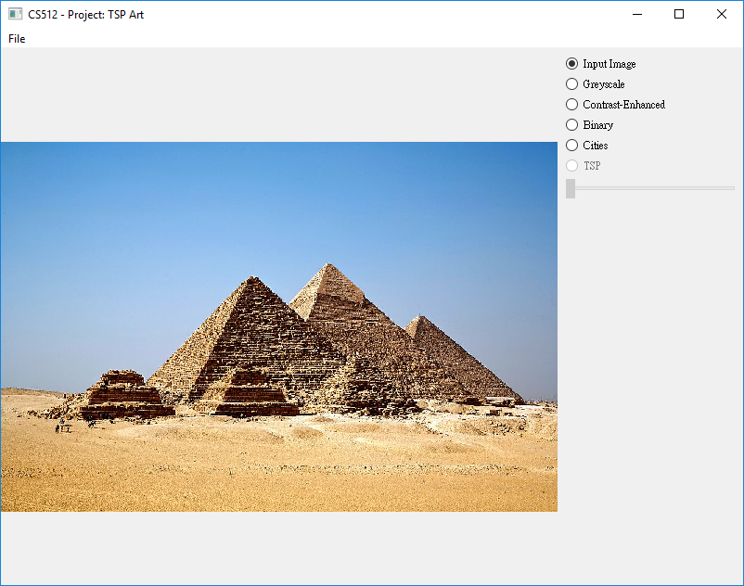
Implementation (contd…)
Screen 3: The input image is displayed for the user’s reference

Slide 11
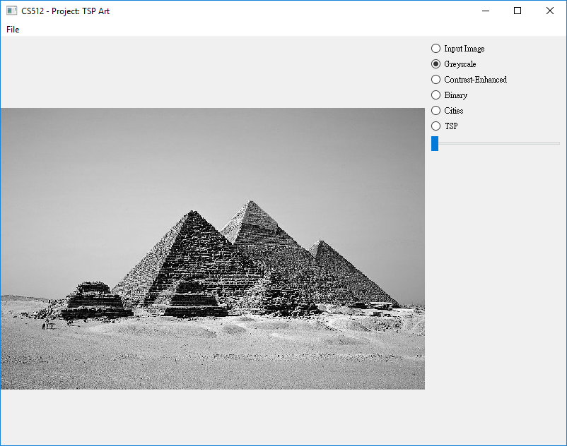
Implementation (contd…)
Screen 4: Preprocessing the image to convert to Grayscale

Slide 12
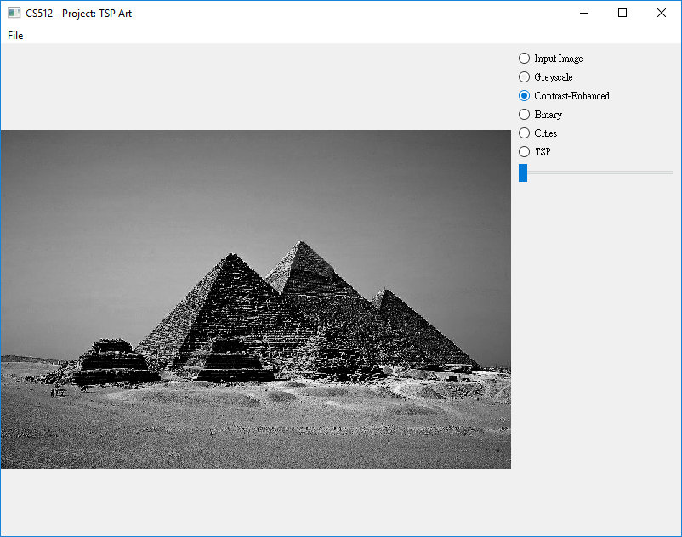
Implementation (contd…)
Screen 5: Preprocessing the image to adjust the contrast

Slide 13
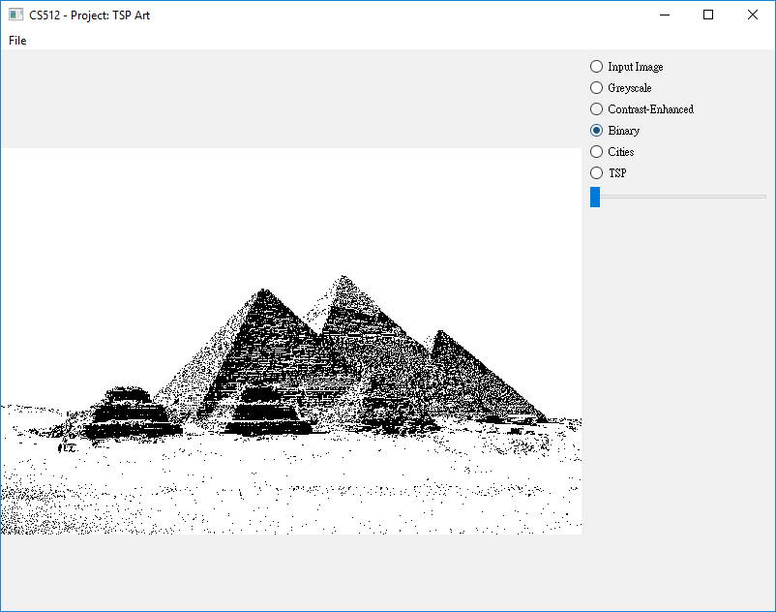
Implementation (contd…)
Screen 6: Preprocessing to binarize the image

Slide 14
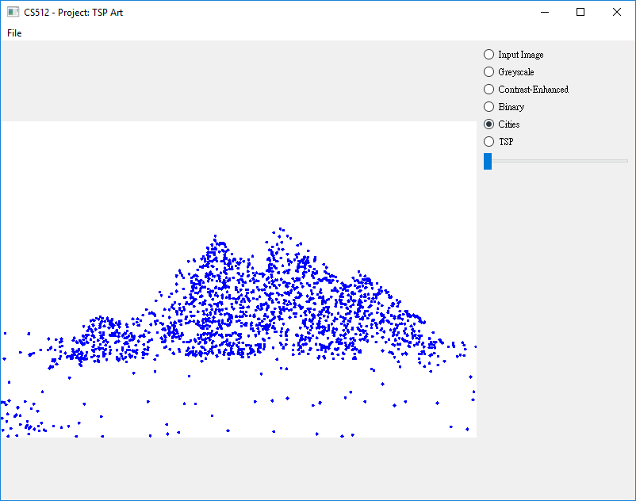
Implementation (contd…)
Screen 7: Random selection of subset of pixels to build cities in the TSP problem

Slide 15
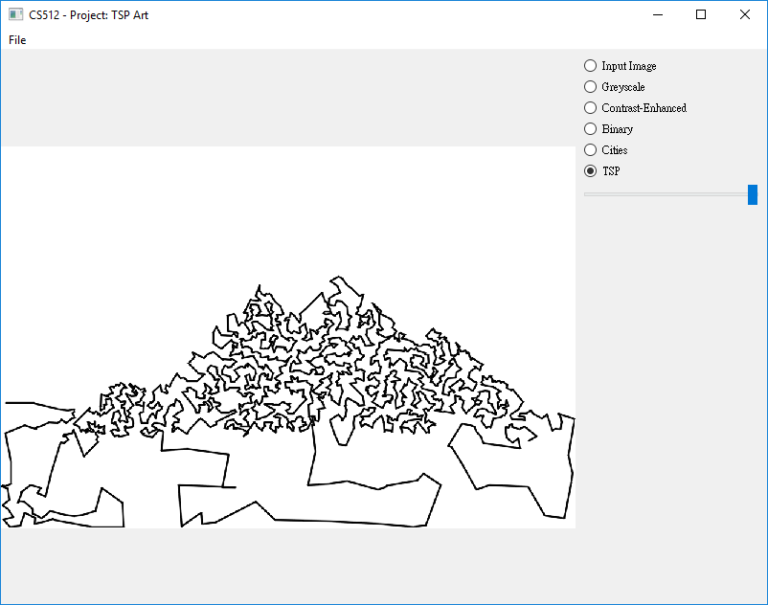
Implementation (contd…)
Screen 8: A step by step visualization of the TSP Art

Slide 16
Project Stumbling blocks

Slide 17
Data collection, Flow diagram

Slide 18
Sample Findings

Slide 19
Future Extensions

Slide 20
Acknowledgements

Slide 21
References

Slide 22
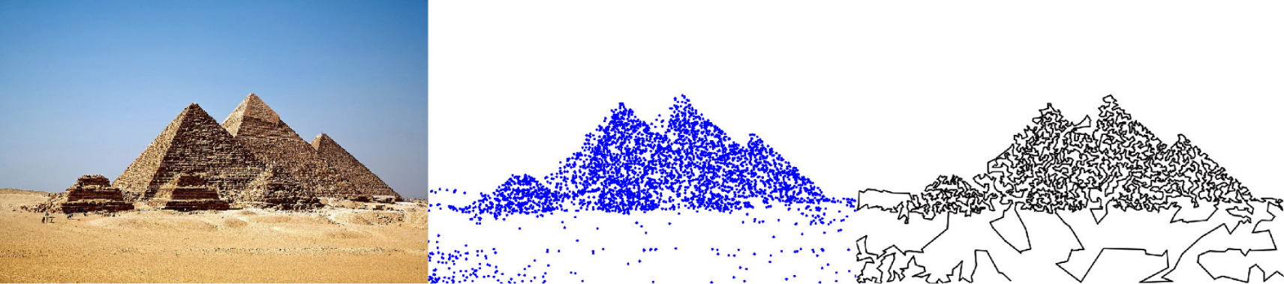
TSP Art
TSP Art is a type of black-and-white line arts. Take an image as input. By visualizing the TSP path and controlling the line density. We can depict a TSP art image:

Slide 23
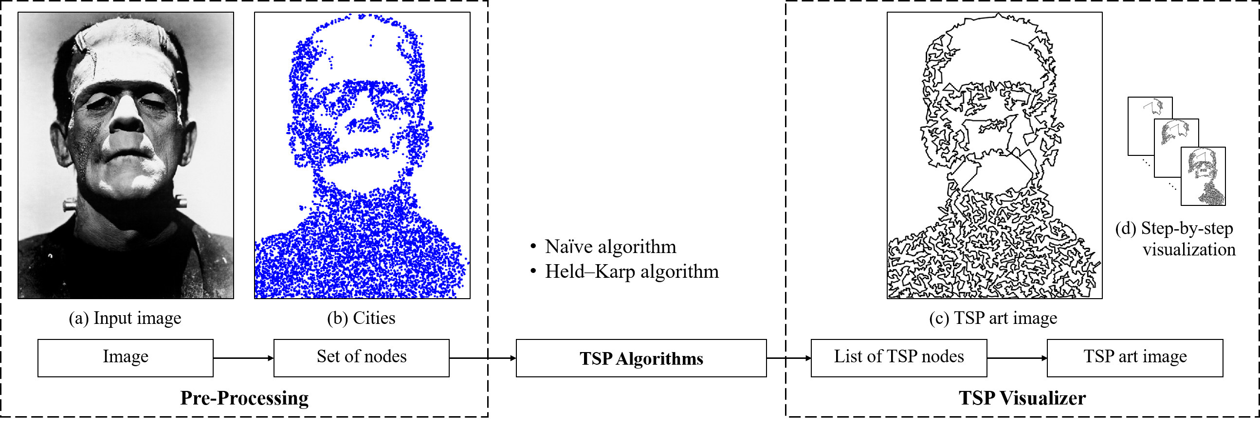
System Flow

Slide 24
Thank You!

